Slide 1
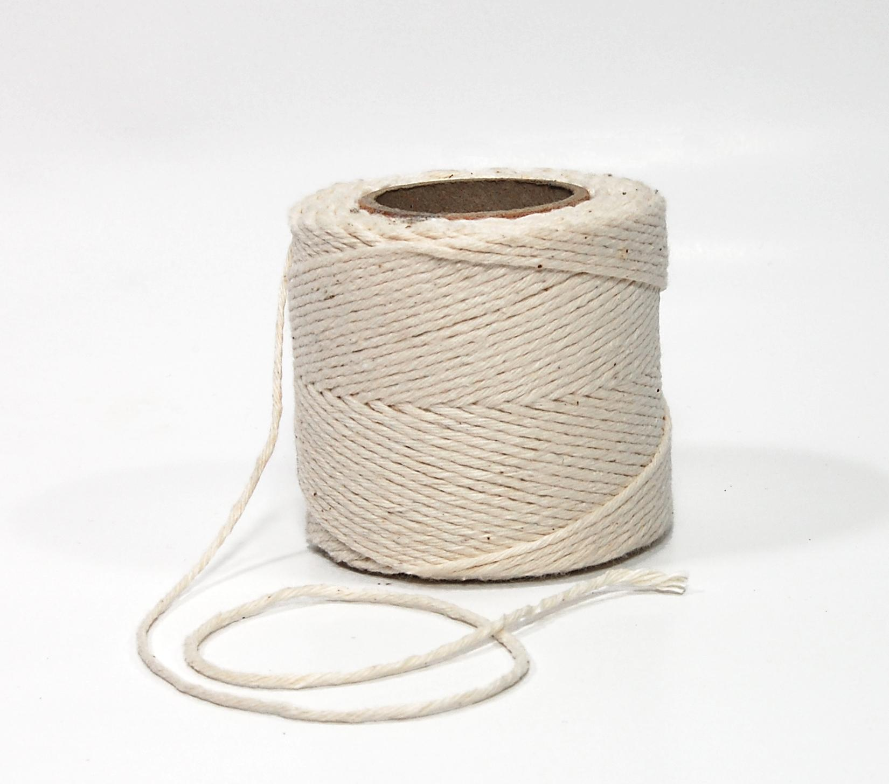
Welcome to CS149 Students to….
THE FOURTH HOUR
TOPIC - Loops and Strings
Notes:
While students are filtering in, circulate a piece of paper for students to write their names on. Include a place for name and professor. If a student came in late, note what time they came in so that we can accurately track data. (The observing TA should probably be the one to manage and record when a student comes in late)

Slide 2

Introductions
Name
Professor
Fun Fact About yourself

Slide 3
What are loops
Loops allow us to perform the same action or similar action over and over again while a certain condition is met.

Slide 4
What are loops
Loops allow us to perform the same action or similar action over and over again while a certain condition is met.
What kind of loops have we learned so far?

Slide 5
What are loops
Loops allow us to perform the same action or similar action over and over again while a certain condition is met.
What kind of loops have we learned so far?
for loop

Slide 6
What are loops
Loops allow us to perform the same action or similar action over and over again while a certain condition is met.
What kind of loops have we learned so far?
for loop
while loop

Slide 7
What are loops
Loops allow us to perform the same action or similar action over and over again while a certain condition is met.
What kind of loops have we learned so far?
for loop
while loop

Slide 8
for loops
What are the parts of a for loop?
for (int i = 0; i < 3; i++) { System.out.println(i);
}

Slide 9
for loops
Initial value (initializer)
for (int i = 0; i < 3; i++) { System.out.println(i);
}

Slide 10
for loops
Condition that must be met
Initial value (initializer)
for (int i = 0; i < 3; i++) { System.out.println(i);
}

Slide 11
for loops
Condition that must be met
Initial value (initializer)
Update
for (int i = 0; i < 3; i++) { System.out.println(i);
}

Slide 12
while loops
While loops are essentially the same, they just loop different.
int i = 0;
while (i < 3) { System.out.println(i);
i++;
}

Slide 13
while loops
int i = 0;
while (i < 3) { System.out.println(i);
i++;
}
Initial value (initializer)

Slide 14
while loops
int i = 0;
while (i < 3) { System.out.println(i);
i++;
}
Initial value (initializer)
Condition that must be met

Slide 15
while loops
int i = 0;
while (i < 3) { System.out.println(i);
i++;
}
Initial value (initializer)
Condition that must be met
Update

Slide 16
Socrative Question 1
Go to https://b.socrative.com/login/student
Classroom name: FOURTHOUR

Slide 17
Socrative Question 1
What is printed by the following:
String str = "abcdefghijklmnop";
for (int i = 1; i < str.length(); i *=2)
{
System.out.print(i + “ “ + str.charAt(i) + “ “);
}
1 a 2 b 4 d 6 f 8 h 10 j 12 l 14 m 16 o
1 b 2 c 4 e 6 g 8 i 10 k 12 m 14 o
1 b 2 c 4 e 8 i
1 a 2 b 4 d 8 h
1 b 3 d 5 f 7 h 9 j 11 l 13 n 15 p

Slide 18
Socrative Question 1
What is printed by the following:
String str = "abcdefghijklmnop";
for (int i = 1; i < str.length(); i *=2)
{
System.out.print(i + “ “ + str.charAt(i) + “ “);
}
1 a 2 b 4 d 6 f 8 h 10 j 12 l 14 m 16 o
1 b 2 c 4 e 6 g 8 i 10 k 12 m 14 o
1 b 2 c 4 e 8 i
1 a 2 b 4 d 8 h
1 b 3 d 5 f 7 h 9 j 11 l 13 n 15 p

Slide 19
Let’s go over the answer on the board
String str = "abcdefghijklmnop";
for (int i = 1; i < str.length(); i *=2)
{
System.out.print(i + “ “ + str.charAt(i) + “ “);
}
Notes:
Use a stack diagram on the board to go over why the answer is the answer. Make sure to note that the first index of the string is 0. I recommend adding an index number under each character in the string.

Slide 20
Activity Time
In groups of 2-3 rewrite the for loop below as a while loop:
String str = "abcdefghijklmnop";
for (int i = 1; i < str.length(); i *=2)
{
System.out.print(i + “ “ + str.charAt(i) + “ “);
}

Slide 21
Solution
String str = "abcdefghijklmnop";
int i = 1;
while(i < str.length())
{
System.out.print(i + “ “ + str.charAt(i) + “ “);
i*=2;
}

Slide 22
Additional changes
Change the code below so that instead of using the charAt method that it is using the substring method:
String str = "abcdefghijklmnop";
int i = 1;
while(i < str.length())
{
System.out.print(i + “ “ + str.charAt(i) + “ “);
i*=2;
}

Slide 23
Solution
String str = "abcdefghijklmnop";
int i = 1;
while(i < str.length())
{
System.out.print(i + “ “ + str.substring(i, i+1) + “ “);
i*=2;
}

Slide 24
Socrative Question 2
What is the value of i when the for loop finishes executing:
String secretMessage = "dlrowolleh";
int i = 1;
for (i = secretMessage.length() - 1; i >= 0; i--) {
System.out.print(secretMessage.charAt(i));
}
10
9
1
0
-1

Slide 25
Socrative Question 2
What is the value of i when the for loop finishes executing:
String secretMessage = "dlrowolleh";
int i = 1;
for (i = secretMessage.length() - 1; i >= 0; i--) {
System.out.print(secretMessage.charAt(i));
}
10
9
1
0
-1

Slide 26
Lets go over the answer:
Using a stack diagram to keep track of the value of i
String secretMessage = "dlrowolleh";
int i = 1;
for (i = secretMessage.length() - 1; i >= 0; i--) {
System.out.print(secretMessage.charAt(i));
}
Notes:
On the board draw stack diagram and walk students through how values of i change in each iteration of for loop

Slide 27
Activity time!
Print out every other letter in the alphabet. Challenge: (you can only use characters no strings)
Work in groups of 2-3 students

Slide 28
Multiple ways to solve the problem:
char letter = 'a';
char endLetter = 'z';
while (letter <= endLetter) {
System.out.println(letter);
letter += 2;
}

Slide 29
Multiple ways to solve the problem:
//26 letters in the alphabet but half is 13
char letter = 'a';
for (int x = 0; x < 13; x++) {
System.out.println(letter);
letter+=2;
}

Slide 30
Socrative Question 3
What is printed out:
for (int x = 1; x < 3; x++) {
for (int y = 2; y > 0; y--) {
System.out.print(x*y + “, “);
}
}
1, 2, 3, 2, 0,
2, 4,
2, 4, 6,
2, 4, 6, 1, 2 , 3,
2, 1, 4, 2,
2, 4, 2, 1,

Slide 31
Socrative Question 3
What is printed out:
for (int x = 1; x < 3; x++) {
for (int y = 2; y > 0; y--) {
System.out.print(x*y + “, “);
}
}
1, 2, 3, 2, 0,
2, 4,
2, 4, 6,
2, 4, 6, 1, 2 , 3,
2, 1, 4, 2,
2, 4, 2, 1,

Slide 32
Use stack diagram to understand why
for (int x = 1; x < 3; x++) {
for (int y = 2; y > 0; y--) {
System.out.print(x*y + “, “);
}
}
Notes:
Draw stack diagram on board

